Slide 1
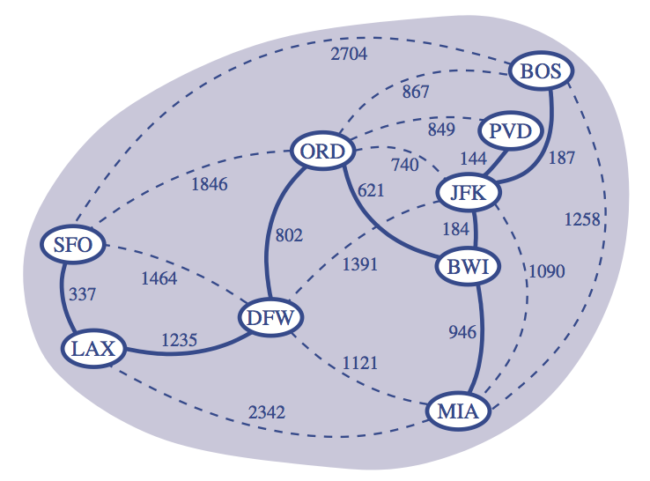
Minimum Spanning Trees
Presentation for use with the textbook Data Structures and Algorithms in Java, 6th edition, by M. T. Goodrich, R. Tamassia, and M. H. Goldwasser, Wiley, 2014

Slide 2
Minimum Spanning Trees
Spanning subgraph
Subgraph of a graph G containing all the vertices of G
Spanning tree
Spanning subgraph that is itself a (free) tree
Minimum spanning tree (MST)
Spanning tree of a weighted graph with minimum total edge weight
Applications
Communications networks
Transportation networks
ORD
10
1
PIT
DEN
6
7
9
3
DCA
4
STL
8
5
2
DFW
ATL

Slide 3
Cycle Property
Cycle Property:
Let T be a minimum spanning tree of a weighted graph G
Let e be an edge of G that is not in T and C let be the cycle formed by e with T
For every edge f of C, weight(f) ≤ weight(e)
Proof:
By contradiction
If weight(f) > weight(e) we can get a spanning tree of smaller weight by replacing e with f
f
8
4
C
9
2
6
3
e
8
7
7
Replacing f with e yields a better spanning tree
f
8
4
C
9
2
6
3
e
8
7
7

Slide 4
Partition Property
U
V
f
7
Partition Property:
Consider a partition of the vertices of G into subsets U and V
Let e be an edge of minimum weight across the partition
There is a minimum spanning tree of G containing edge e
Proof:
Let T be an MST of G
If T does not contain e, consider the cycle C formed by e with T and let f be an edge of C across the partition
By the cycle property, weight(f) ≤ weight(e)
Thus, weight(f) = weight(e)
We obtain another MST by replacing f with e
4
9
2
5
8
8
e
3
7
Replacing f with e yields another MST
U
V
f
7
4
9
2
5
8
8
e
3
7

Slide 5
Prim-Jarnik’s Algorithm
Similar to Dijkstra’s algorithm
We pick an arbitrary vertex s and we grow the MST as a cloud of vertices, starting from s
We store with each vertex v label d(v) representing the smallest weight of an edge connecting v to a vertex in the cloud
At each step:
We add to the cloud the vertex u outside the cloud with the smallest distance label
We update the labels of the vertices adjacent to u

Slide 6
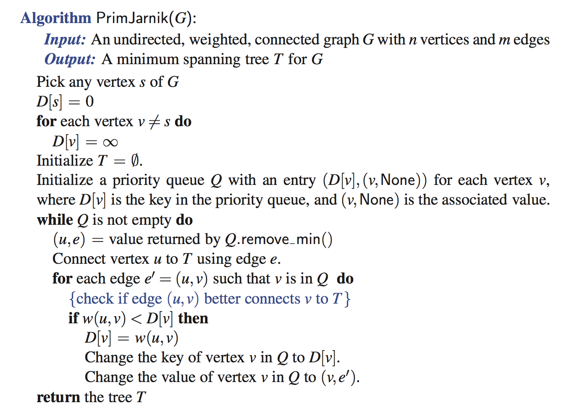
Prim-Jarnik Pseudo-code

Slide 7
Example
∞
7
2
7
D
2
7
D
B
4
B
4
8
9
∞
5
9
∞
2
5
F
2
5
F
C
8
C
8
8
3
8
3
E
E
A
7
7
A
7
7
0
0
7
7
2
7
D
7
D
B
4
2
B
4
5
9
∞
9
4
2
5
F
5
5
C
2
F
8
C
8
8
3
3
E
8
A
7
E
0
7
A
7
7
0

Slide 8
Example (contd.)
7
2
7
D
B
4
5
9
4
2
5
F
C
8
8
3
E
A
7
3
7
0
7
D
2
B
4
5
9
4
2
5
F
C
8
8
3
E
A
7
3
0

Slide 9
Analysis
Graph operations
We cycle through the incident edges once for each vertex
Label operations
We set/get the distance, parent and locator labels of vertex z O(deg(z)) times
Setting/getting a label takes O(1) time
Priority queue operations
Each vertex is inserted once into and removed once from the priority queue, where each insertion or removal takes O(log n) time
The key of a vertex w in the priority queue is modified at most deg(w) times, where each key change takes O(log n) time
Prim-Jarnik’s algorithm runs in O((n + m) log n) time provided the graph is represented by the adjacency list structure
Recall that Σ_{v} deg(v) = 2m
The running time is O(m log n) since the graph is connected

Slide 10
Kruskal’s Approach
Maintain a partition of the vertices into clusters
Initially, single-vertex clusters
Keep an MST for each cluster
Merge “closest” clusters and their MSTs
A priority queue stores the edges outside clusters
Key: weight
Element: edge
At the end of the algorithm
One cluster and one MST

Slide 11
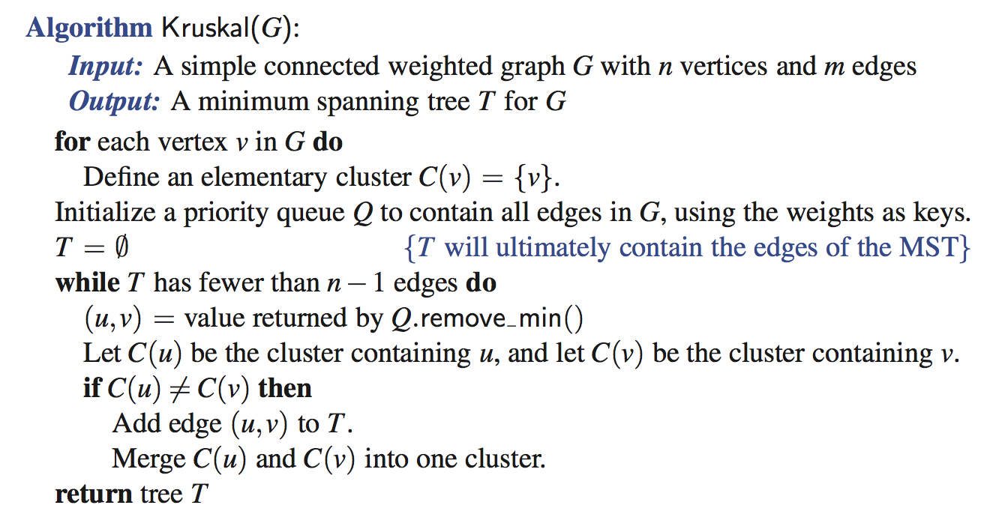
Kruskal’s Algorithm

Slide 12
Example
G
G
B
8
8
4
B
4
9
E
6
9
E
6
1
5
F
1
5
F
C
11
3
C
11
3
2
2
7
D
H
7
H
A
D
10
A
10
G
G
B
8
B
8
4
4
9
E
6
9
E
6
1
5
F
1
5
F
C
11
3
C
11
3
2
2
7
D
H
7
H
D
A
10
A
10

Slide 13
Example (contd.)
G
G
B
8
8
4
B
4
9
E
6
9
E
6
1
5
F
1
5
F
C
11
3
C
11
3
2
2
7
D
H
7
H
D
A
10
A
10
four steps
two steps
G
G
B
8
B
8
4
4
9
E
6
9
E
6
1
5
F
1
5
F
C
11
3
C
11
3
2
2
7
D
H
7
D
H
A
10
A
10

Slide 14
Data Structure for Kruskal’s Algorithm
The algorithm maintains a forest of trees
A priority queue extracts the edges by increasing weight
An edge is accepted it if connects distinct trees
We need a data structure that maintains a partition, i.e., a collection of disjoint sets, with operations:
makeSet(u): create a set consisting of u
find(u): return the set storing u
union(A, B): replace sets A and B with their union

Slide 15
List-based Partition
Each set is stored in a sequence
Each element has a reference back to the set
operation find(u) takes O(1) time, and returns the set of which u is a member.
in operation union(A,B), we move the elements of the smaller set to the sequence of the larger set and update their references
the time for operation union(A,B) is min(|A|, |B|)
Whenever an element is processed, it goes into a set of size at least double, hence each element is processed at most log n times

Slide 16
Partition-Based Implementation
Partition-based version of Kruskal’s Algorithm
Cluster merges as unions
Cluster locations as finds
Running time O((n + m) log n)
Priority Queue operations: O(m log n)
Union-Find operations: O(n log n)

Slide 17
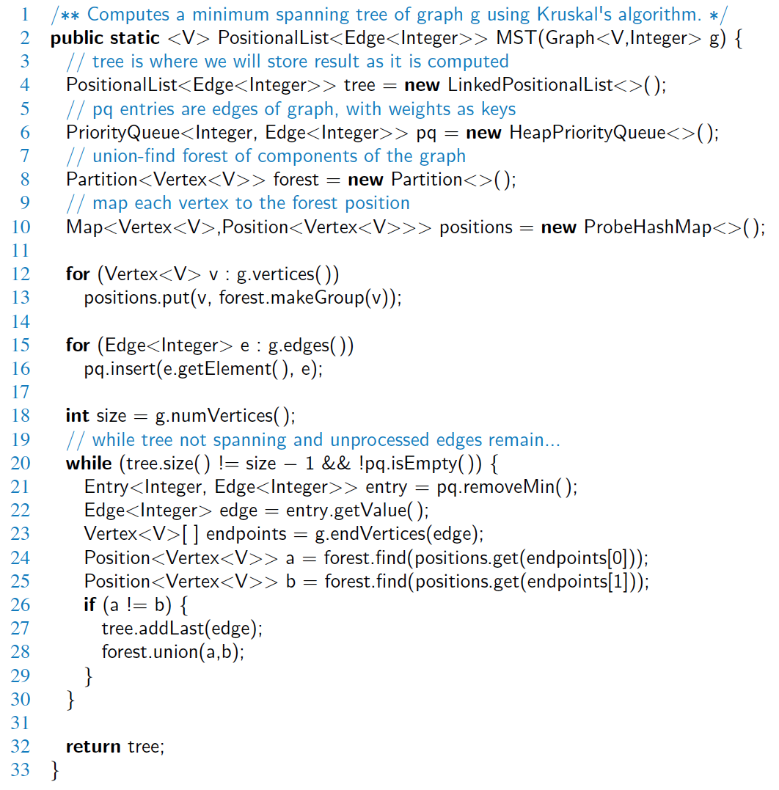
Java Implementation

Slide 18
Java Implementation, 2

Slide 19
Baruvka’s Algorithm (Exercise)
Like Kruskal’s Algorithm, Baruvka’s algorithm grows many clusters at once and maintains a forest T
Each iteration of the while loop halves the number of connected components in forest T
The running time is O(m log n)
Algorithm BaruvkaMST(G)
T ← V {just the vertices of G}
while T has fewer than n − 1 edges do
for each connected component C in T do
Let edge e be the smallest-weight edge from C to another component in T
if e is not already in T then
Add edge e to T
return T

Slide 20
Example of Baruvka’s Algorithm (animated)
Slide by Matt Stallmann included with permission.
2
4
3
8
5
8
9
4
7
4
9
3
1
6
6
6
5
4
2
4
3
8
5
9
4
7
3
1
6
6
5
4

